Slide 1

Heap Sort Algorithm
Mashiwat Tabassum Waishy
Lecturer

Slide 2




Definitions of heap:
A heap is a data structure that stores a collection of objects (with keys), and has the following properties:
Complete Binary tree(CBT)
Heap Order

Slide 3

The heap sort algorithm has two major steps :
The first major step involves transforming the complete tree into a heap.
The second major step is to perform the actual sort by extracting the largest or lowerst element from the root and transforming the remaining tree into a heap.

Slide 4

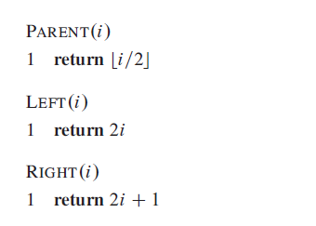

Slide 5
Types of heap
Max Heap
Min Heap

Slide 6

Max Heap Example
19
12
16
1
4
7
19 | 12 | 16 | 1 | 4 | 7
Array A

Slide 7

Min heap example
1
4
16
7
12
19
1 | 4 | 16 | 7 | 12 | 19
Array A

Slide 8


1-Max heap :
Max-heap Definition:
is a complete binary tree in which the value in each internal node is greater than or equal to the values in the children of that node.
Max-heap property:
The key of a node is ≥ than the keys of its children.

Slide 9

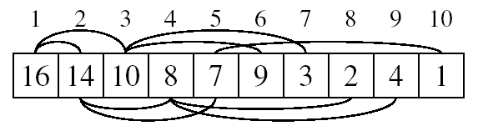
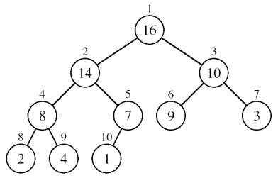
Max heap Operation
A heap can be stored as an array A.
Root of tree is A[1]
Left child of A[i] = A[2i]
Right child of A[i] = A[2i + 1]
Parent of A[i] = A[ ⎣i/2⎦ ]

Slide 10

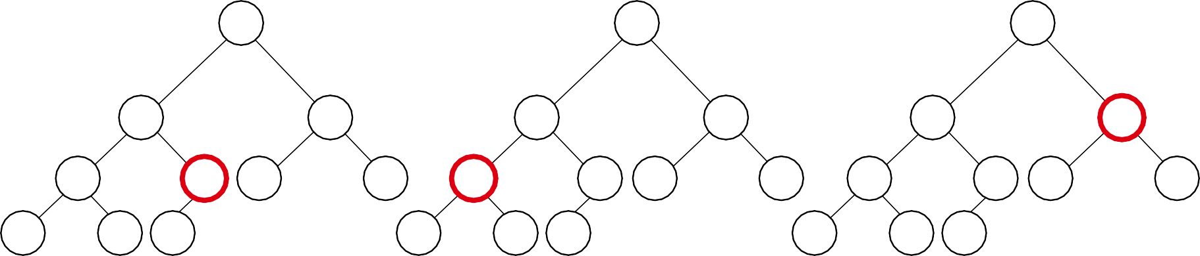
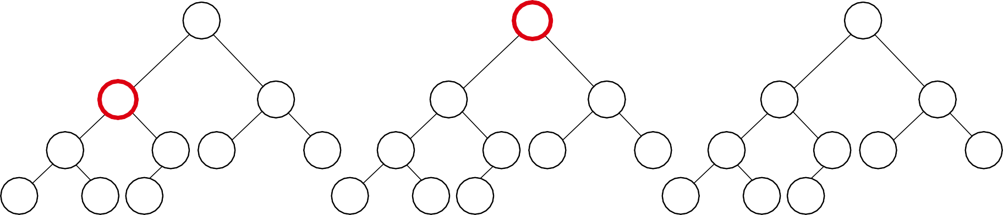
Example Explaining : A
4 | 1 | 3 | 2 | 16 | 9 | 10 | 14 | 8 | 7
i = 5
i = 4
i = 3
1 | 1 | 1
4 | 4 | 4
2
1
3
3
2
1
3
3
2
1
3
3
4 | 5 | 6 | 7 | 4 | 5 | 6 | 7 | 4
2 9 | 16 10 | 9 | 10 8 | 2 9 | 16 10 | 9 | 10 8 | 14
5 6
16 9
7
10
8 |  |  |  |  |  |  | 9 | 10
14 | 8 | 7 | 14 | 8 | 7 | 2 | 8 | 7
i = 2
1
4
i = 1
1
4
1
16
2
1
3
10
2
16
3
10
2
14
3
10
4 | 5 | 6 | 7 | 4 | 5 | 6 | 7 | 4
14 9 | 16 10 | 9 | 3 8 | 14 9 | 7 10 | 9 | 3 8 | 8
5 6
7 9
7
3
8 |  |  |  |  |  |  | 9 | 10
2 | 8 | 7 | 2 | 8 | 1 | 2 | 4 | 1

Slide 11

Build Max-heap
Heapify() Example
16
4
10
14
7
9
3
2
8
1
A =
16 | 4 | 10 | 14 | 7 | 9 | 3 | 2 | 8 | 1

Slide 12

Heapify() Example
16
4
10
14
7
9
3
2
8
1
A = 16
4 | 10 | 14 | 7 | 9 | 3 | 2 | 8 | 1

Slide 13

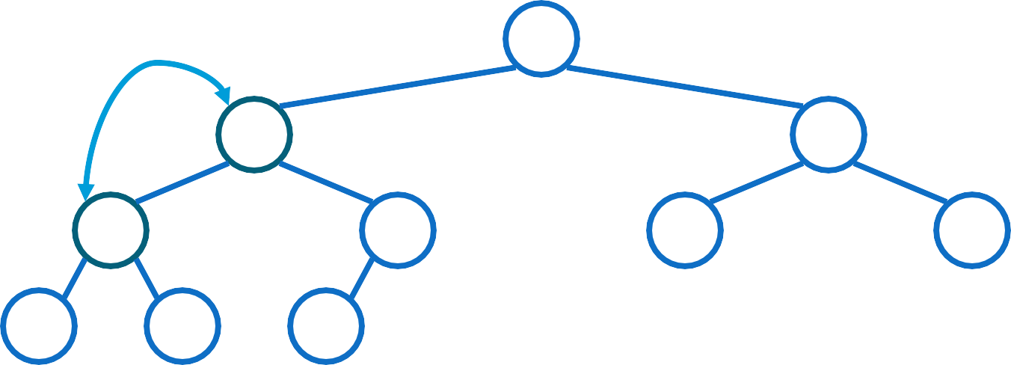
Heapify() Example
16
4
10
14
7
9
3
2
8
1
A = 16 4 10
14 | 7 | 9 | 3 | 2 | 8 | 1

Slide 14

Heapify() Example
16
14
10
4
7
9
3
2
8
1
A =
16 | 14 | 10 | 4 | 7 | 9 | 3 | 2 | 8 | 1

Slide 15

Heapify() Example
16
14
10
4
7
9
3
2
8
1
A =
16 | 14 | 10 4 7 | 9 | 3 | 2 | 8 | 1

Slide 16

Heapify() Example
16
14
10
4
7
9
3
2
8
1
A =
16 | 14 | 10 | 4 | 7 | 9 | 3 | 2 | 8 | 1

Slide 17

Heapify() Example
16
14
10
8
7
9
3
2
4
1
A =
16 | 14 | 10 | 8 | 7 | 9 | 3 | 2 | 4 | 1

Slide 18

Heapify() Example
16
14
10
8
7
9
3
2
4
1
A =
16 | 14 | 10 | 8 | 7 | 9 | 3 | 2 4 1

Slide 19

Heapify() Example
16
14
10
8
7
9
3
2
4
1
A =
16 | 14 | 10 | 8 | 7 | 9 | 3 | 2 | 4 | 1

Slide 20

Heap-Sort sorting strategy:
Build Max Heap from unordered array;
Find maximum element A[1];
Swap elements A[n] and A[1] :
now max element is at the end of the array! .
Discard node n from heap
(by decrementing heap-size variable).
New root may violate max heap property, but its children are max heaps. Run max_heapify to fix this.
Go to Step 2 unless heap is empty.

Slide 21

HeapSort() Example
A = {16, 14, 10, 8, 7, 9, 3, 2, 4, 1}
1
16
2
14
3
10
4
8
5
7
6
9
7
3
8
2
9
4
10
1

Slide 22

HeapSort() Example
A = {14, 8, 10, 4, 7, 9, 3, 2, 1, 16}
1
14
2
8
3
10
4
4
5
7
6
9
7
3
8
2
9
1
16
i = 10

Slide 23

HeapSort() Example
A = {10, 8, 9, 4, 7, 1, 3, 2, 14, 16}
1
10
2
8
3
9
4
4
5
7
6
1
7
3
8
2
14
i = 9
16
10

Slide 24

HeapSort() Example
A = {9, 8, 3, 4, 7, 1, 2, 10, 14, 16}
1
9
2
8
3
3
4
4
5
7
6
1
7
2
10
i = 8
14
9
16
10

Slide 25

HeapSort() Example
A = {8, 7, 3, 4, 2, 1, 9, 10, 14, 16}
1
8
2
7
3
3
4
4
5
2
6
1
9
i = 7
10
8
14
9
16
10

Slide 26

HeapSort() Example
A = {7, 4, 3, 1, 2, 8, 9, 10, 14, 16}
1
7
2
4
3
3
4
1
5
2
8
i = 6
9
7
10
8
14
9
16
10

Slide 27

HeapSort() Example
A = {4, 2, 3, 1, 7, 8, 9, 10, 14, 16}
1
4
2
2
3
3
4
1
i = 5
7
8
6
9
7
10
8
14
9
16
10

Slide 28

HeapSort() Example
A = {3, 2, 1, 4, 7, 8, 9, 10, 14, 16}
1
3
2
2
3
1
i = 4
4
7
5
8
6
9
7
10
8
14
9
16
10

Slide 29

HeapSort() Example
A = {2, 1, 3, 4, 7, 8, 9, 10, 14, 16}
1
2
2
1
i = 3
3
4
4
7
5
8
6
9
7
10
8
14
9
16
10

Slide 30

HeapSort() Example
A = {1, 2, 3, 4, 7, 8, 9, 10, 14, 16} >>ordered
1
1
i =2
2
3
3
4
4
7
5
8
6
9
7
10
8
14
9
16
10

Slide 31

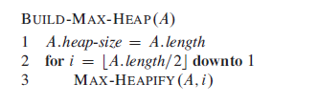
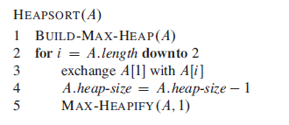
Heap Sort pseducode

Slide 32
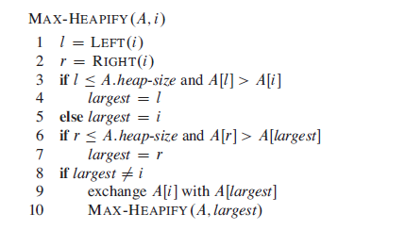

Slide 33


2-Min heap :
Min-heap Definition:
is a complete binary tree in which the value in each internal node is lower than or equal to the values in the children of that node.
Min-heap property:
The key of a node is <= than the keys of its children.

Slide 34

Min heap Operation
A heap can be stored as an array A.
Root of tree is A[1]
Left child of A[i] = A[2i]
Right child of A[i] = A[2i + 1]
Parent of A[i] = A[ ⎣i/2⎦ ]
33

Slide 35

Min Heap
19
12
16
1
4
7
19 | 12 | 16 | 1 | 4 | 7
Array A

Slide 36

Min Heap phase 1
19
1
16
12
4
7

Slide 37

Min Heap phase 1
1
19
7
12
4
16

Slide 38

Min Heap phase 1
1
4
7
12
19
16
1,

Slide 39

Min Heap phase 2
16
4
7
12
19

Slide 40

Min Heap phase 2
4
16
7
12
19

Slide 41

Min Heap phase 2
4
12
7
16
19
1,4

Slide 42

Min Heap phase 3
19
12
7
16

Slide 43

Min Heap phase 3
7
12
19
16
1,4,7

Slide 44

Min Heap phase 4
16
12
19

Slide 45

Min Heap phase 4
12
16
19
1,4,7,12

Slide 46

Min Heap phase 5
19
16

Slide 47

Min Heap phase 5
16
19
1,4,7,12,16

Slide 48

Min Heap phase 7
19
1,4,7,12,16,19

Slide 49

Min heap final tree
1
4
7
12
16
19
1 | 4 | 7 | 12 | 16 |  | 19
Array A

Slide 50

Insertion
Algorithm
Add the new element to the next available position at the
lowest level
Restore the max-heap property if violated
General strategy is percolate up (or bubble up): if the parent of the element is smaller than the element, then interchange the parent and child.
OR
Restore the min-heap property if violated
General strategy is percolate up (or bubble up): if the parent of the element is larger than the element, then interchange the parent and child.

Slide 51

19
19
12
16
12
16
4
7
1
4
7
17
1
Insert 17
19
12
17
swap
1
4 7 16
Percolate up to maintain the heap property

Slide 52

Conclusion
The primary advantage of the heap sort is its efficiency. The execution time efficiency of the heap sort is O(n log n).
The memory efficiency of the heap sort, unlike the other n log n sorts, is constant, O(1), because the heap sort algorithm is not recursive.

